Slide 1
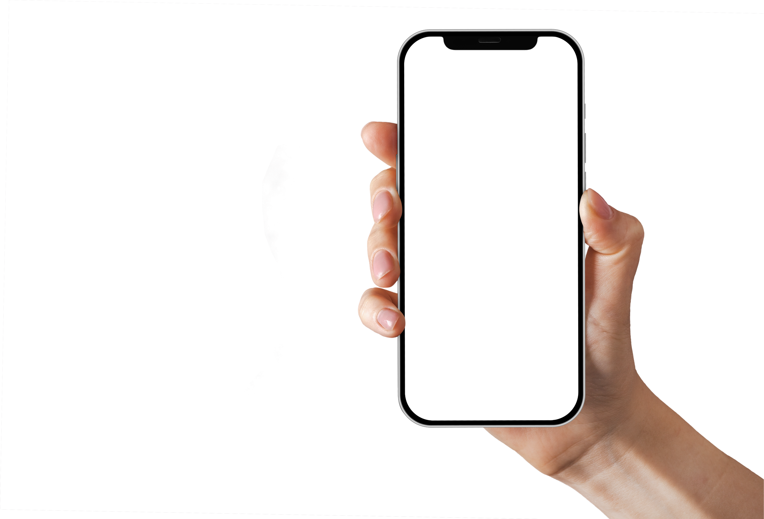


user
Interface Design
Task 5
Group8

Slide 2

Introduction
wireFraming
DeSIGN IMPLementaTion
HANDLING EXCEPTIONS
EVALUATION AND VALIDATION
Outline

Slide 3
General
InTRODUCTION
After the requirements have been gathered and Analyzed there is need to present the user with an intuitive and pleasant user interface that they can use for Navigation along the road
Notes:
Meanwhile requirement gathering and analysis is essential for developing mobile applications. Providing the user with a good user interface and experience is of outmost importance. To make sure that we provide a good and intuitive design we focus on the following.

Slide 4
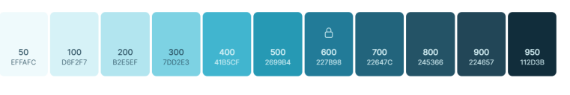
color
Definition
Selecting colors is step in creating a good design. Our Design is going to make use of the Jelly Blue which means;
- Safety of users during their journey while using the app
- Secureness of user’s data (personal and location information)
- Trust in information coming from the app
Notes:
Color: Which brings a sense of mood and awareness in this design we used the color Jelly blue and variants which means
Safety
Secureness and
Trust

Slide 5

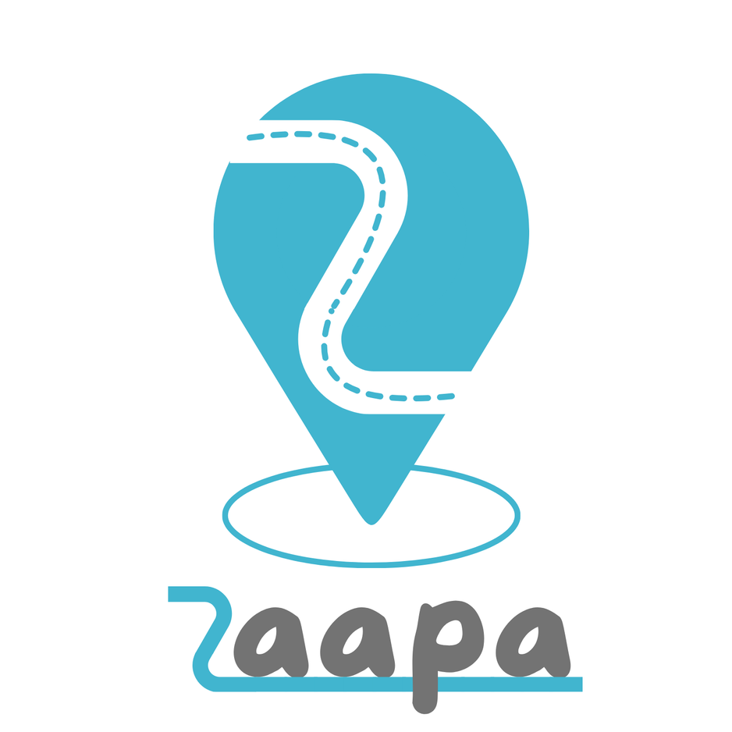
Applications Name
The app name is the first point of interaction between the user and the app. It sets the tone for what users can expect. The name chosen for this app is "Zaapa"
This is gotten from a Cameroonian western Language which actually means “Take this Way”.
Notes:
The applications names is the first point of interaction with the users hence has to be intuitive
We bring to you our apps names Zaapa application, this name was inspired from western Cameroonian language which means take this way,
For example

Slide 6
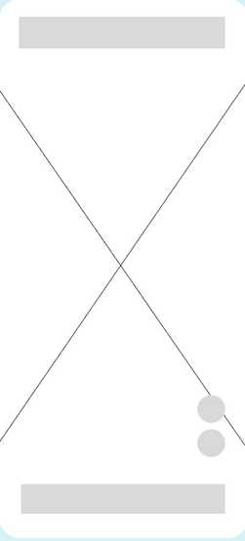
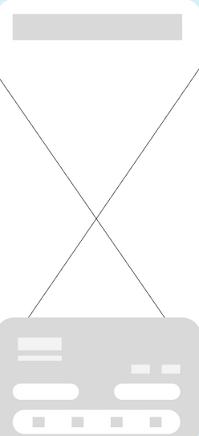
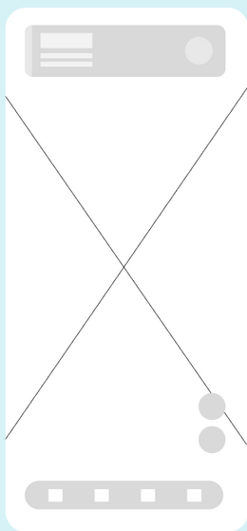

WIRE
FRAMING
Wireframing is a crucial step in UI/UX design process, serving as the blueprint for an app’s structure and functionality. It provides a skeletal framework of the app, focusing on layout and content placement without the distraction of visual design elements. The wireframe provides basis for some design principles including harmony, gestalt, rhythm and alignment of the different design elements.

Slide 7
DESIGN
IMPLEMENTATION
This involves creating a visual representation of our requirements they are classified into;
Authentication
HomeScreen
Settings
Learning Page
Admin Pages

Slide 8

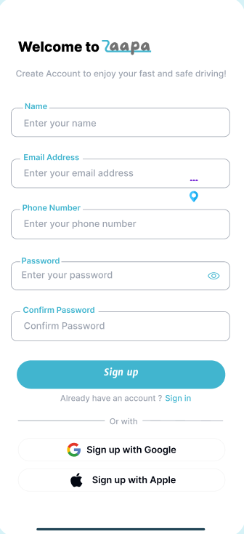
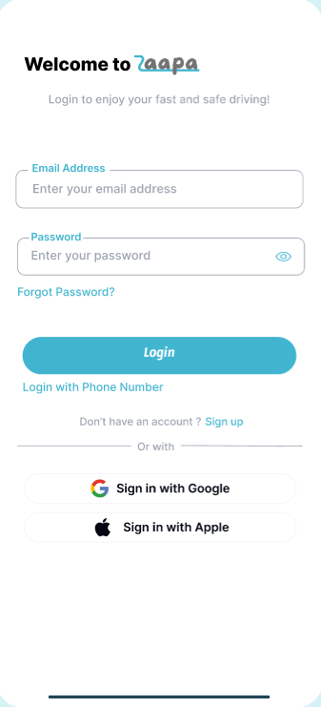
AUTHENTICATION PAGE

Slide 9
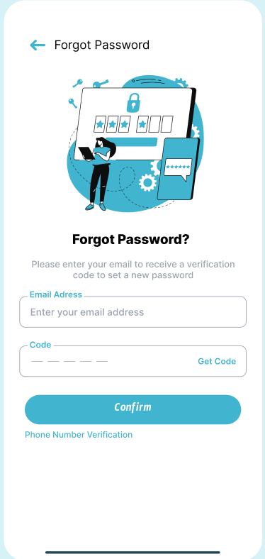
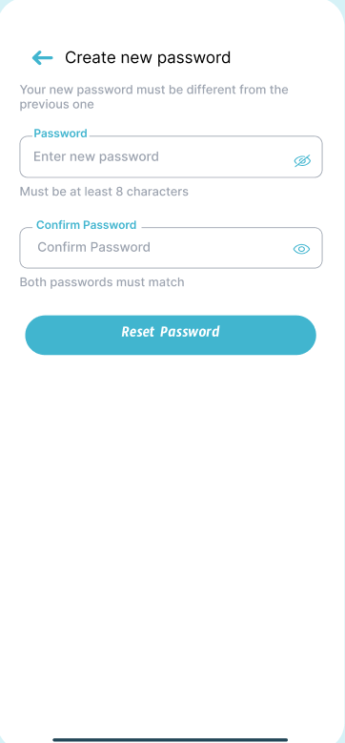
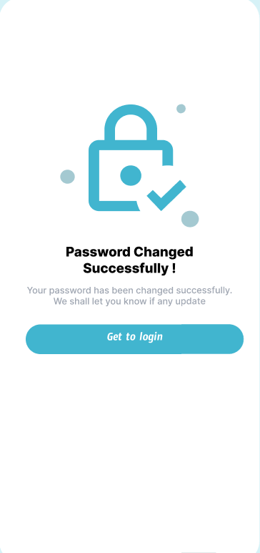
AUTHENTICATION PAGE

Slide 10
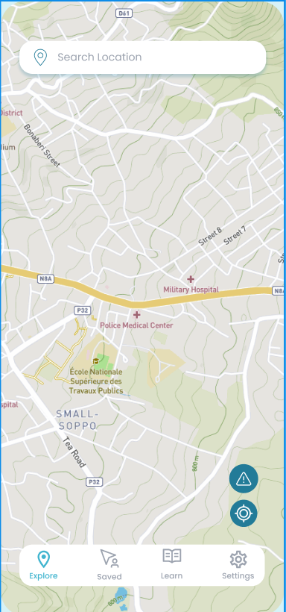
Home Screen
The Home screen of our application displays the main functionalities of our application. Such as viewing the maps. The user is also capable of setting his destination.

Slide 11
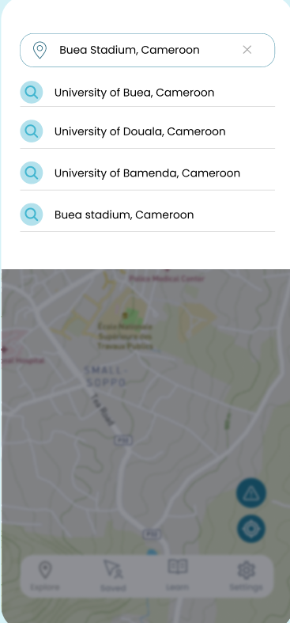
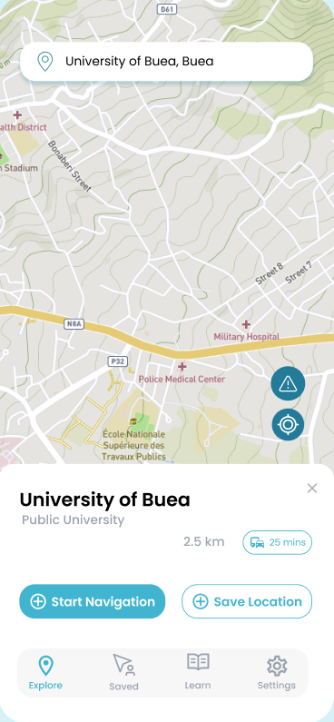
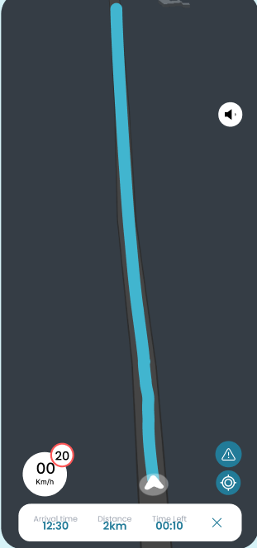
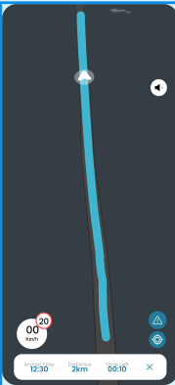
navigation with zaapa

Slide 12
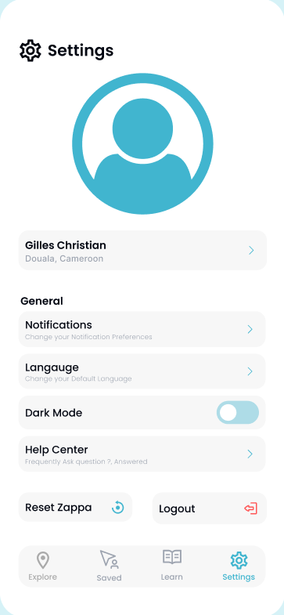
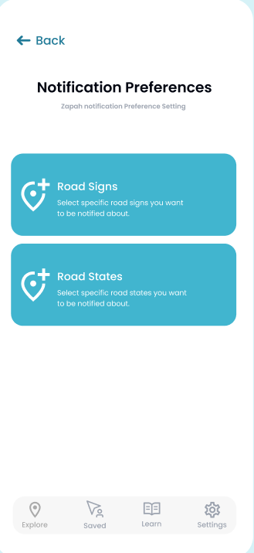
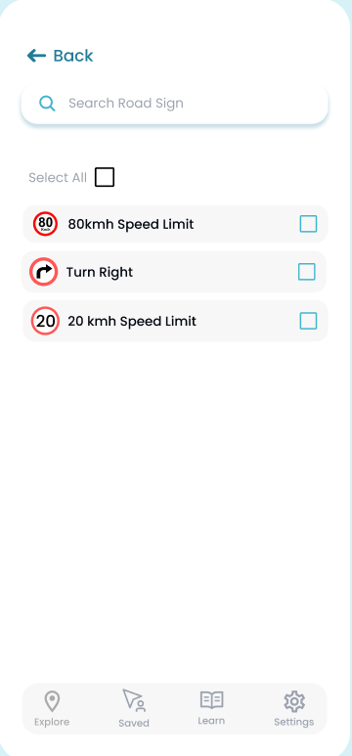
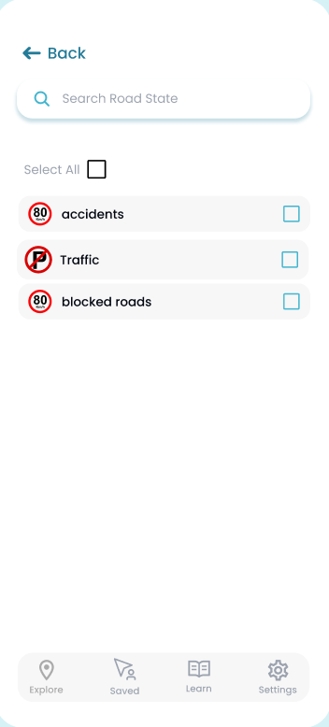
Setting preference

Slide 13
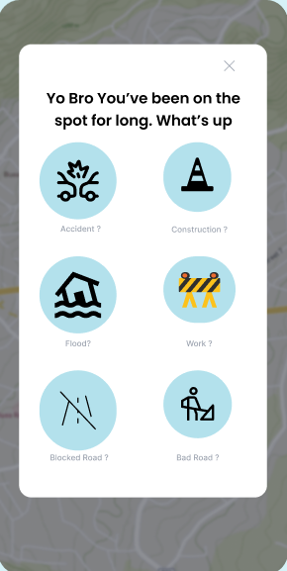
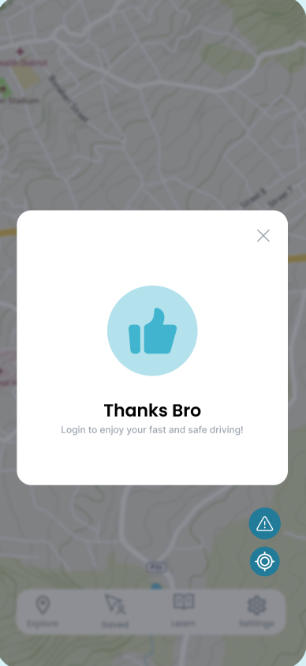
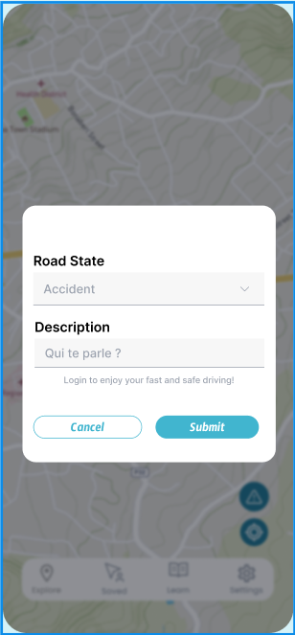
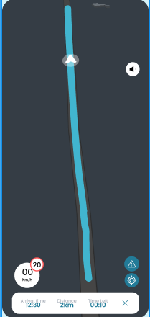
using Data providers to update road condition

Slide 14
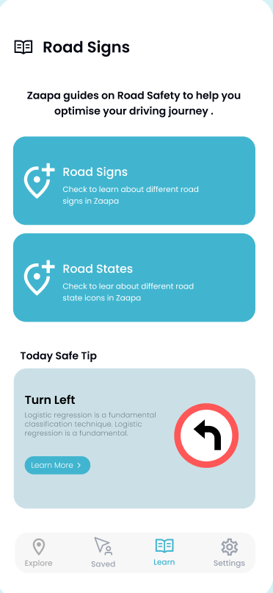
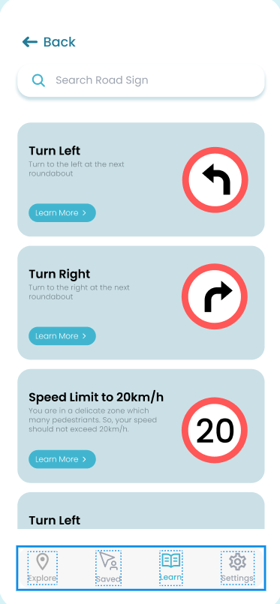
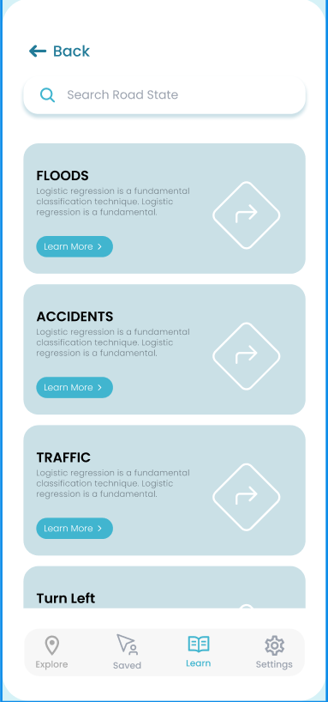
learning with about road signs

Slide 15
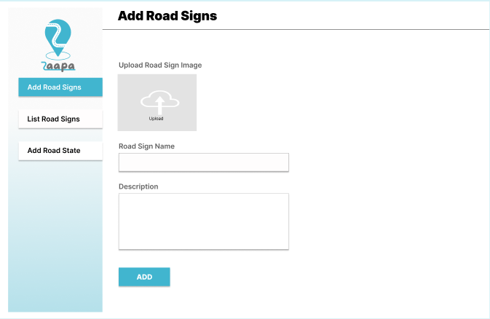
admin dashboard
The Admin is here to monitor our system and make sure that the users are provided with reliable data. A Web Interface is developed to ease the Admin’s Management.

Slide 16

handling exception
Exception handling is about make the program robust and error tolerant.
The occurrence of the error obstruct the normal flow of the application
Hence they must be handled properly to provide the user with a good interface.

Slide 17
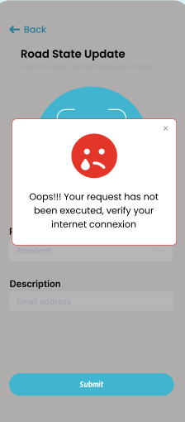
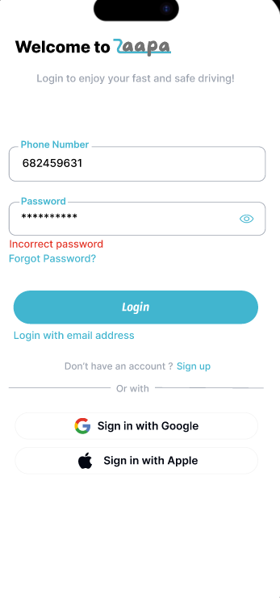
handling exception
1.Internet Connection
2. INcorrect Credientials
Here we handled
Poor Internet Connection
Incorrect user credentials such as password, code

Slide 18


EVALUATION AND validation
Evaluation and validation ensure that the final product meets the intended design principles and usability criteria. This section describes how the design of Zaapa was rigorously assessed (evaluated) to ensure that it aligns with the design best practices, usability criteria and design principles and validated to ensure it provides an optimal user experience, aligns with best practices in design, and meets the needs of its users

Slide 19
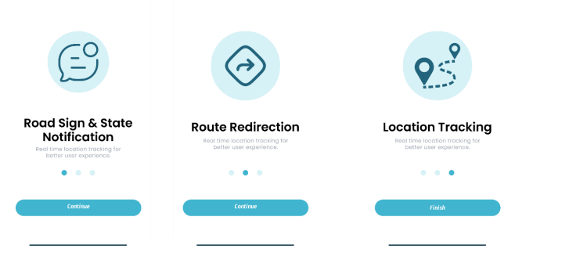
EVALUATION
Using Design Criteria by Nielson to check is the design is up to Standard. Here we see the UNITY, HIRARCHY,RHYTHM and ALIGNMENT criteria.

Slide 20
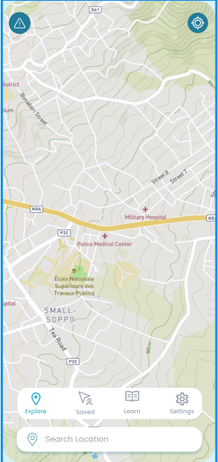
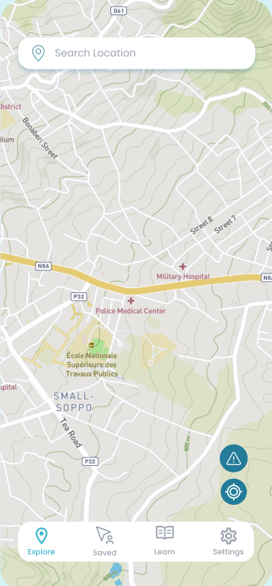

VALIDATION
This Stage involves us testing the avaliable design with target users. So that their feedback can help us produce a great interface to increase their experience.

Slide 21
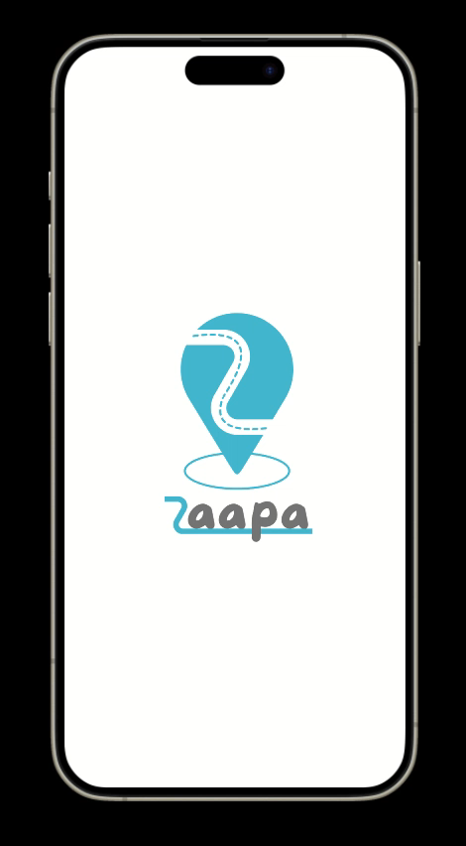
DEMO

Slide 22

CONCLUSION
In conclusion, the design and development of Zaapa involved a meticulous and iterative process
that focused on creating a cohesive, user-centric app

